Slide 1
A Failure forecasting Approach leveraging Sensing and AI/ML
Prepared by
Ahmed Ben Sidhom
PhD Candidate
Digital Engineering Hub (DEHUb)
Dept. of Electrical & Computer Engineering Dept.
Advisors: Dr. Antonios Kontsos & Dr. Nidhal Bouaynaya

Slide 2
Outline:
Introduction to RUL
Objective
Approach
Results
Next steps

Slide 3
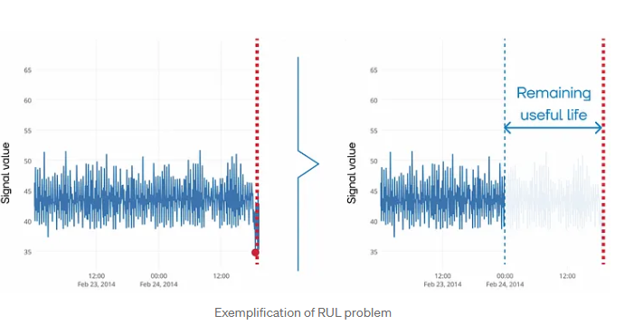
RUL
In International Standards about condition monitoring and diagnostics of machines, RUL is defined as remaining time before system health falls below a defined failure threshold (or before the system passes into a state in which it needs to be repaired or replaced).
This means that, at each point in time, one can estimate the time left until a critical state, indicated by the red dotted line. The time can be expressed in days, cycles, runs, casts, or some other units, proceeding from the problem statement and available data

Slide 4
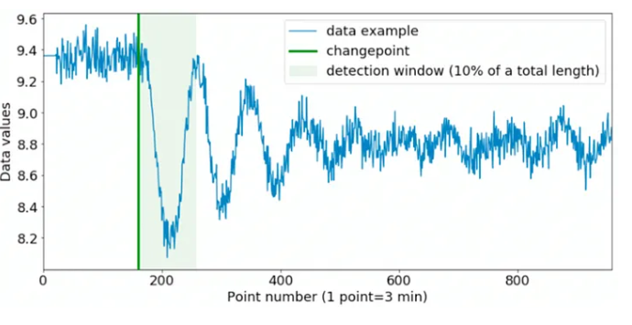
RUL Data
data on equipment operation, i.e., process parameter values, sensor signals for the entire period of operation from the moment of start-up to the moment of failure

Slide 5
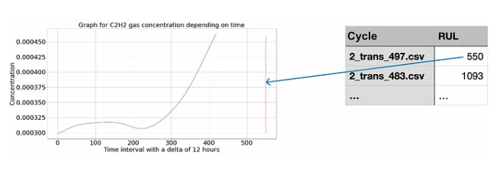
RUL Data
data on operation time to failure (i.e., the duration of operation before the failure occurred)

Slide 6
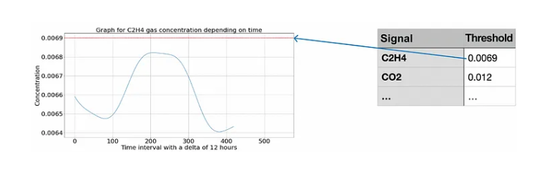
RUL Data
information on thresholds (permissible values) for individual signals or health indicators that point to failure if achieved.

Slide 7
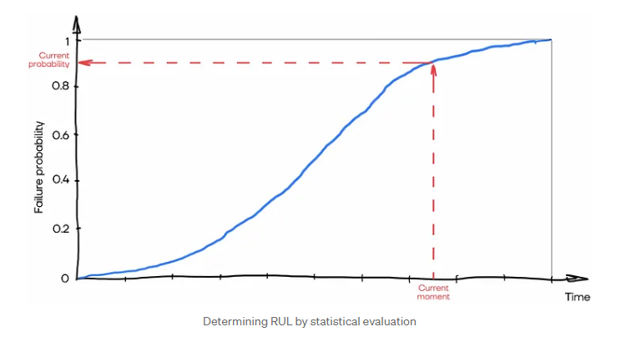
RUL Approaches to solving the RUL estimation problem
1. Statistical evaluation
In statistical evaluation approach, the time-to-failure distribution function is built on historical data to estimate the RUL of equipment; refer to the figure below.

Slide 8
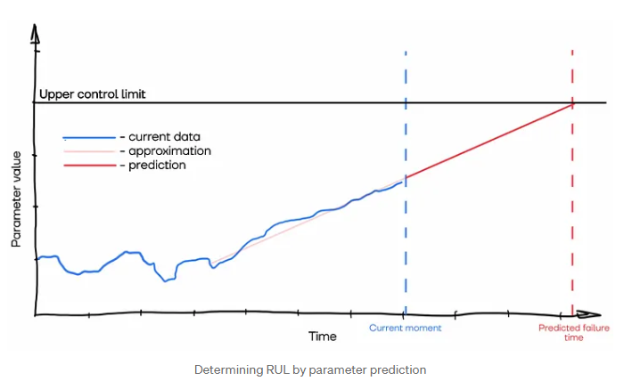
RUL Approaches to solving the RUL estimation problem
2. Parameter prediction
In parameter prediction method, the RUL estimation is based on the prediction of parameter values before the threshold is achieved. This approach is also called the degradation model approach, in which there are two main laws of degradation:
Linear degradation: the prediction is presented as a straight line while historical data determine its slope; it is usually applied if the system does not accumulate damage (degradation).
Exponential degradation: the prediction is presented as an exponent; it is usually applied if the system can accumulate damage cumulatively.
In this case, there are two options:
1. to predict sensor signals,
2. to predict health indicator.

Slide 9
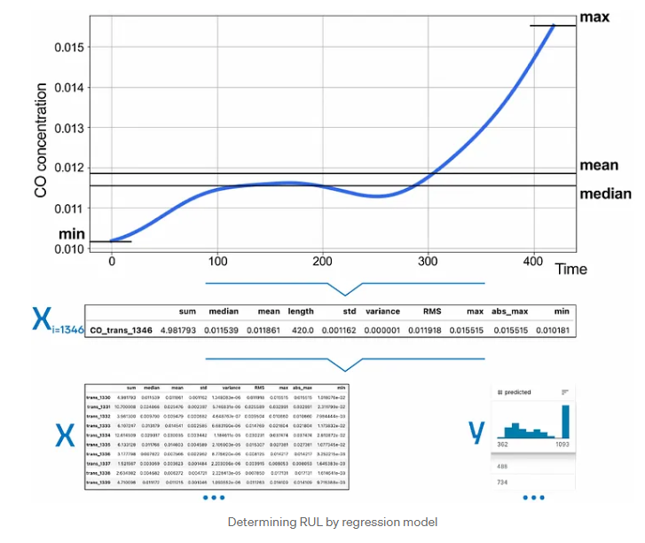
RUL Approaches to solving the RUL estimation problem
3. Regression model
In this case, we reduce the problem to the classical regression formulation.
To do this, extract features from time series (process parameters or health indices)
As a result, we obtain a sample of features X, and we also need a sample of responses (time to failure) y. Thus, this approach requires data on equipment operation (process parameters, sensor signals) and data on operation time to failure, and the problem can be solved as a classical regression problem with tabular data

Slide 10
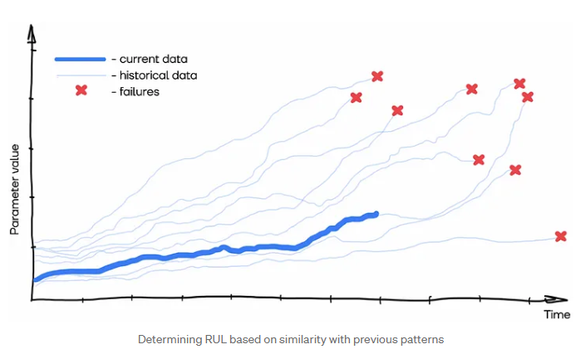
RUL Approaches to solving the RUL estimation problem
4. Similarity with patterns from previous periods
Another very common approach to RUL estimation, also known as the similarity model, is comparing current operation or condition with historical data. To do that, we can cut previous periods in operation at the same moment in time as the current period.
There are two main options to implement the similarity model:
Direct comparison of time series using proximity metrics
Selection of features from a time series and further comparison of the obtained feature vectors (i.e., proximity metrics, clustering).
The desired RUL estimation will be the value of the most similar operation period from the history or the average (or any other aggregation) over a group / cluster of operation periods

Slide 11
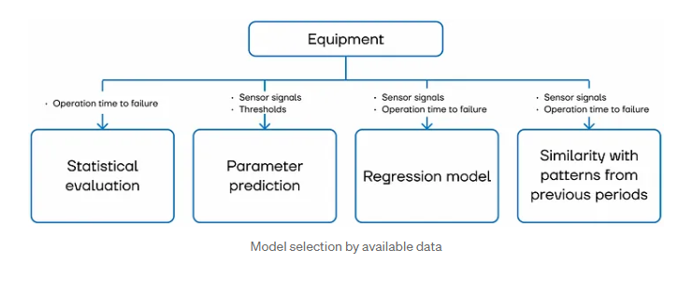
RUL Summary

Slide 12
Objective
Given an uncontrolled physical parameter of a system that evolves over time, we would like to use sensing data and an AI/ML approach to perform focasting:
Assumptions:
Sensor data are sensitive enough to follow the evolution of the physical system
The experiment can be controlled, i.e. there are controllable parameters that we can define to repeat the experiment and therefore produce several training sets
Datasets (>2) are available
For a test dataset some (>5%) of the dataset is used to forecast the rest
Failure for this test case is when the uncontrollable parameter drops to zero (arbitrary units)

Slide 13
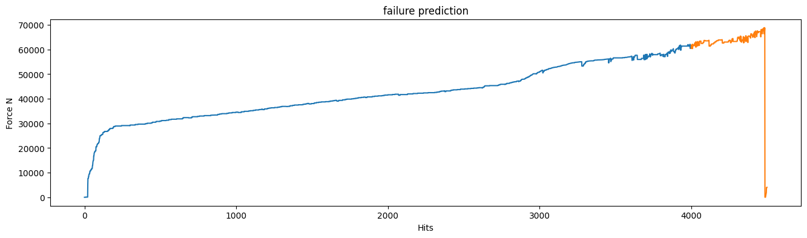
Objective Test Case
We are using mechanical testing data produced in the laboratory by means of a test frame on which we grip a material specimen. The material could be anything (metal, polymer etc.). The test frame could be of any type. A requirement for the test frame is that it can provide to us force and displacement over time. For this test case, the displacement is the controllable parameter (e.g., 1mm/min). The load is the uncontrollable parameter (i.e. it is not known a priori) but it is measurable by the system (i.e. a load cell). Therefore, in lack of prior knowledge if a random material is tested, a user will not know in general when failure will occur. This applies for any type of loading e.g. monotonic tension/compression or cyclic or anything else.
Prediction
Used data until prediction
Failure
Uncontrollable parameter
A measure of progression, e.g. time

Slide 14
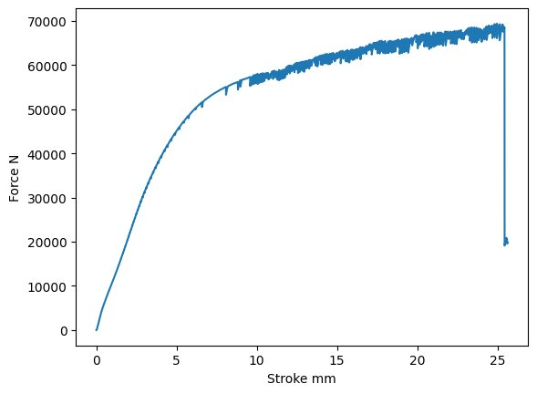
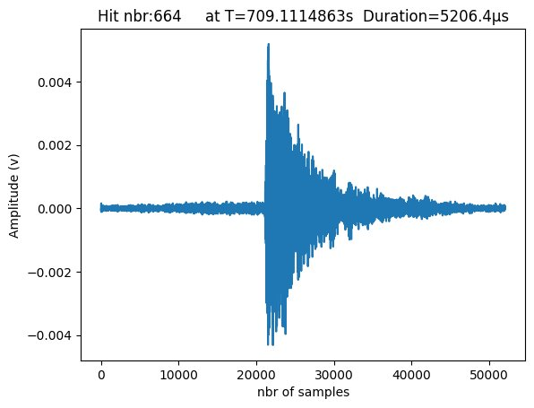
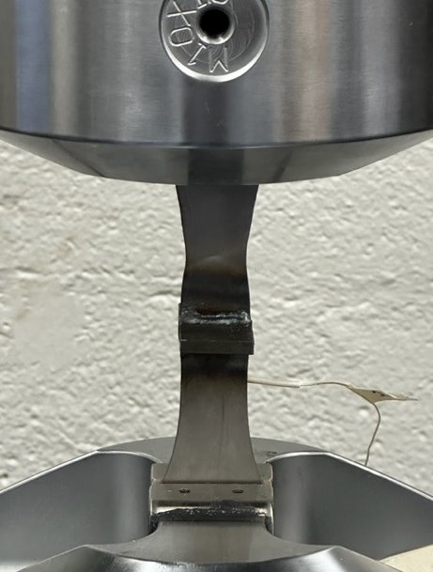
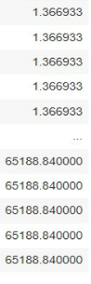
Approach (for the test case): Data collection
AE System
Specimen
Test Frame
amplitude
duration
energy
rms
rise_time
time
counts

Slide 15
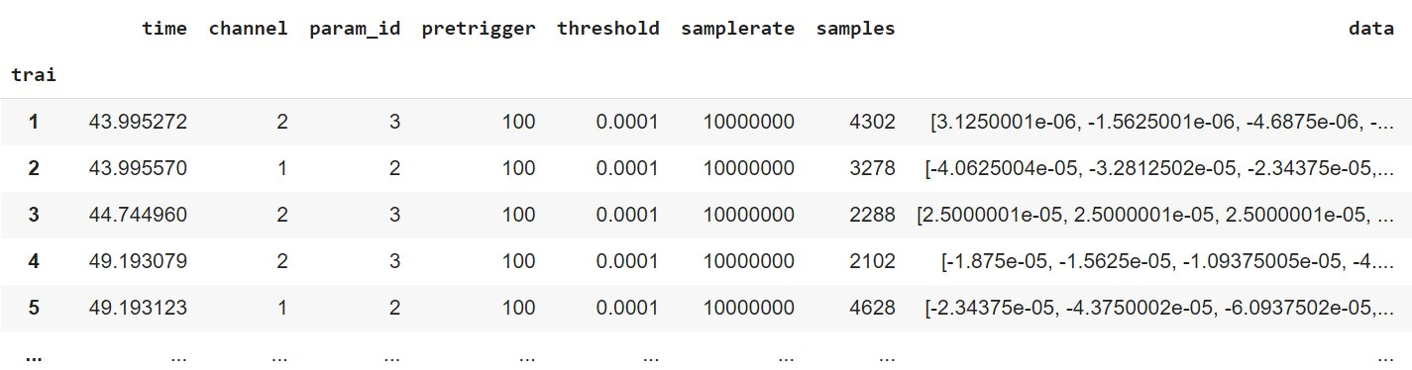
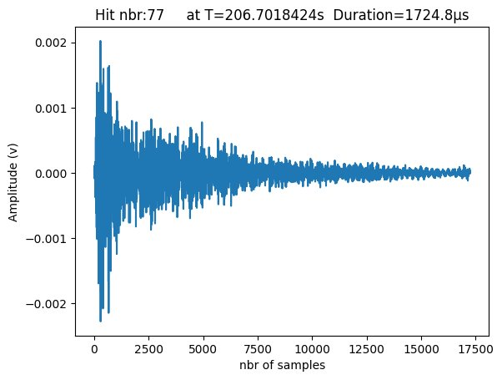
Approach (for the test case): AE Raw data

Slide 16
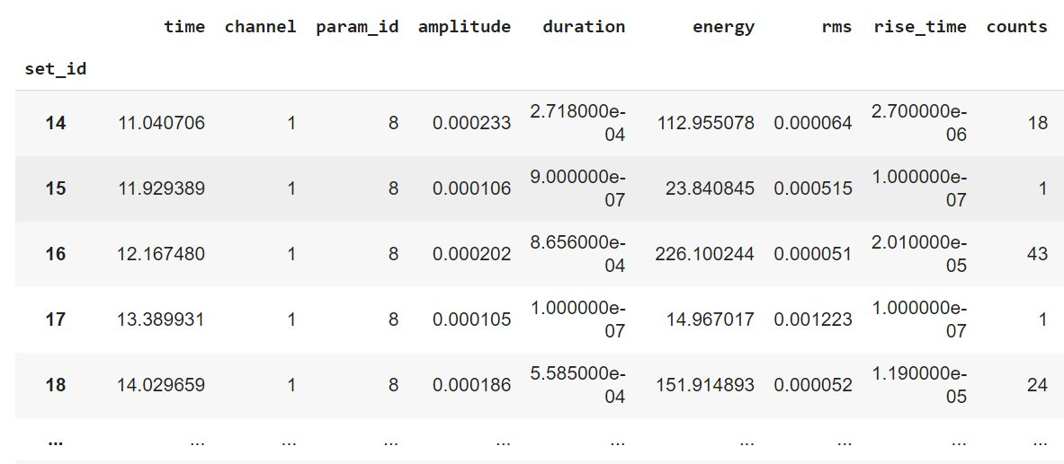
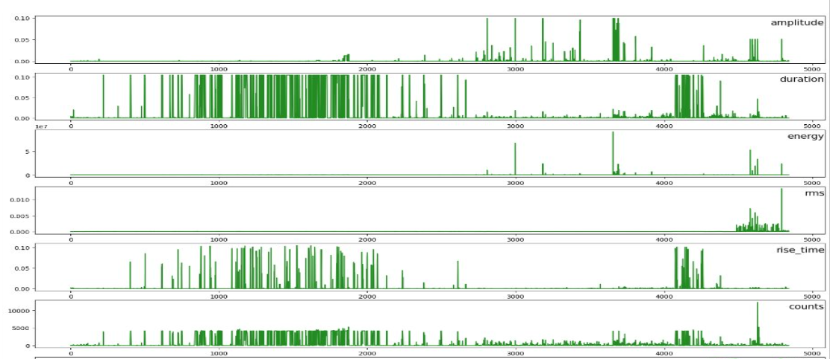
Approach (for the test case): AE Extracted Features

Slide 17
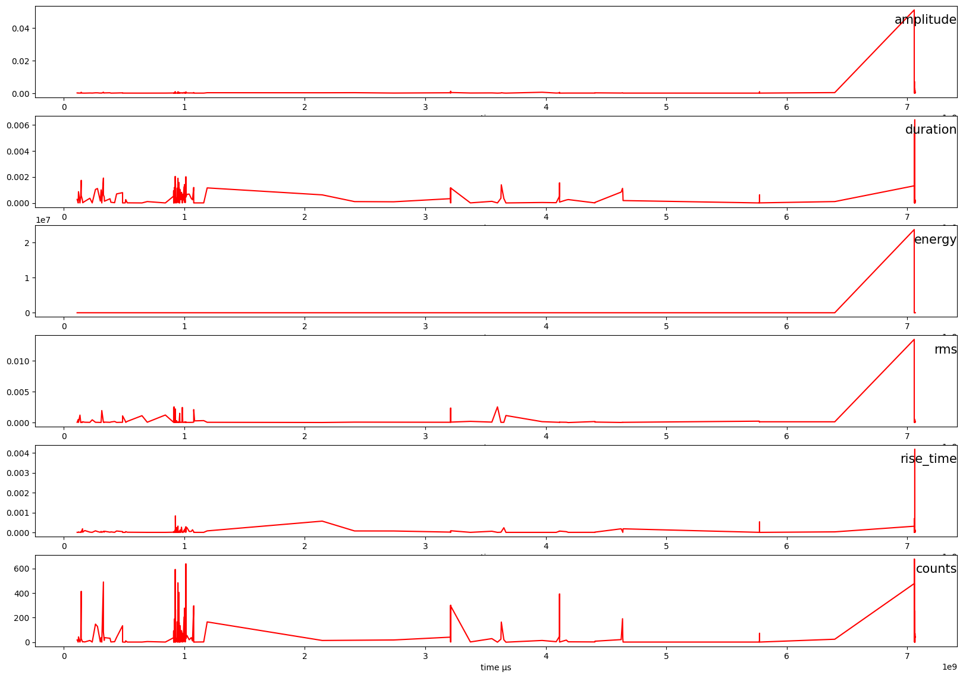
Approach (for the test case): Dataset Test1 AE data

Slide 18
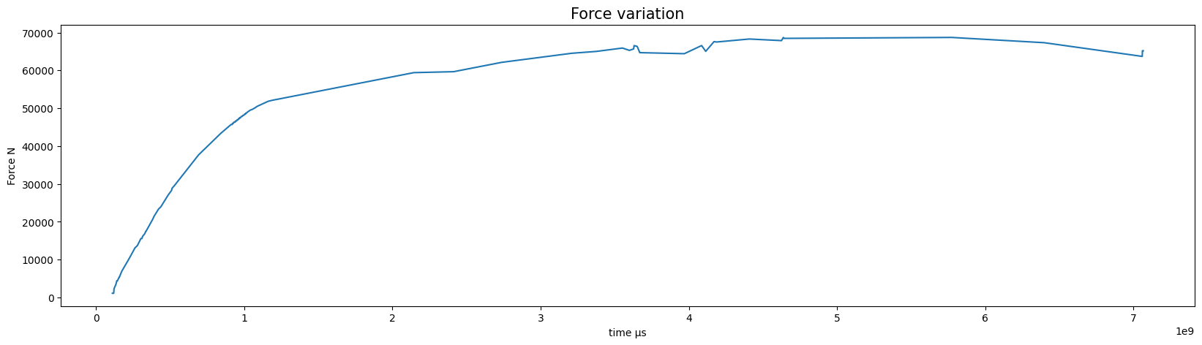
Approach (for the test case): Dataset Test1 Load data

Slide 19
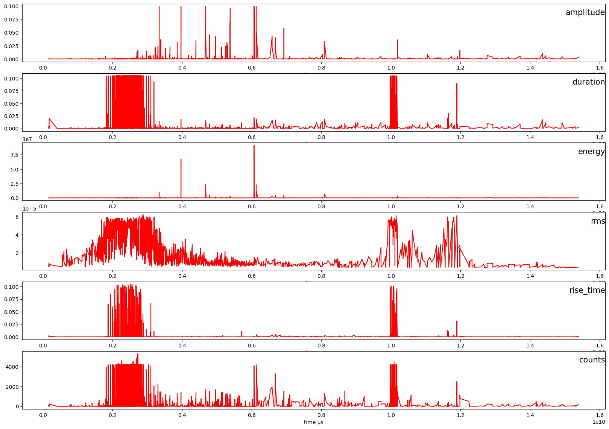
Approach (for the test case): Dataset Test2 AE data

Slide 20
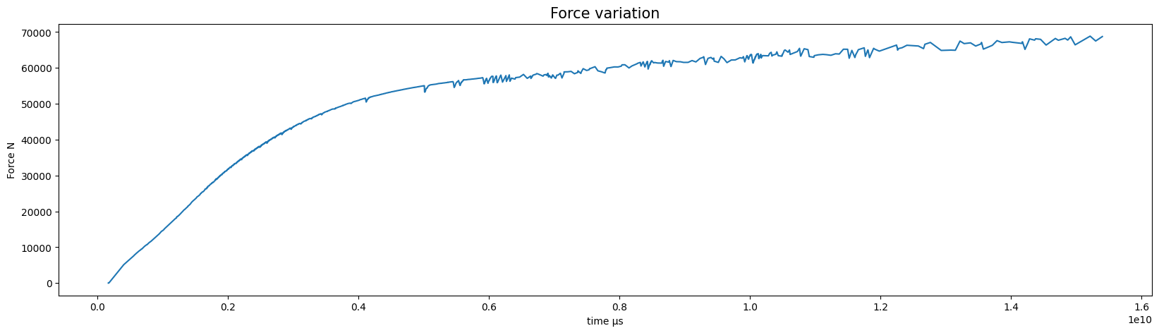
Approach (for the test case): Dataset Test2 Load data

Slide 21
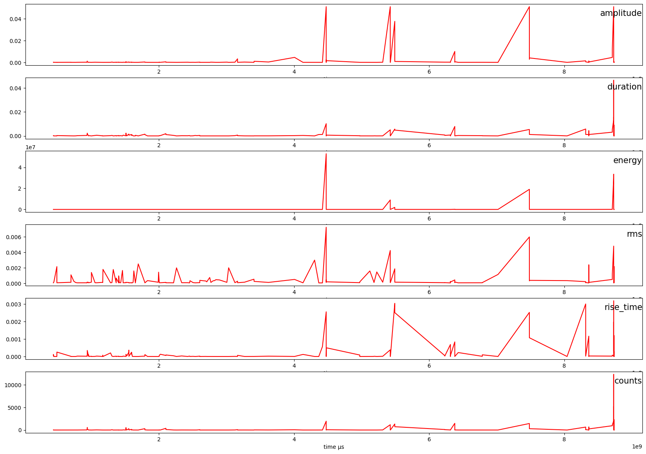
Approach (for the test case): Dataset Test3 AE data

Slide 22
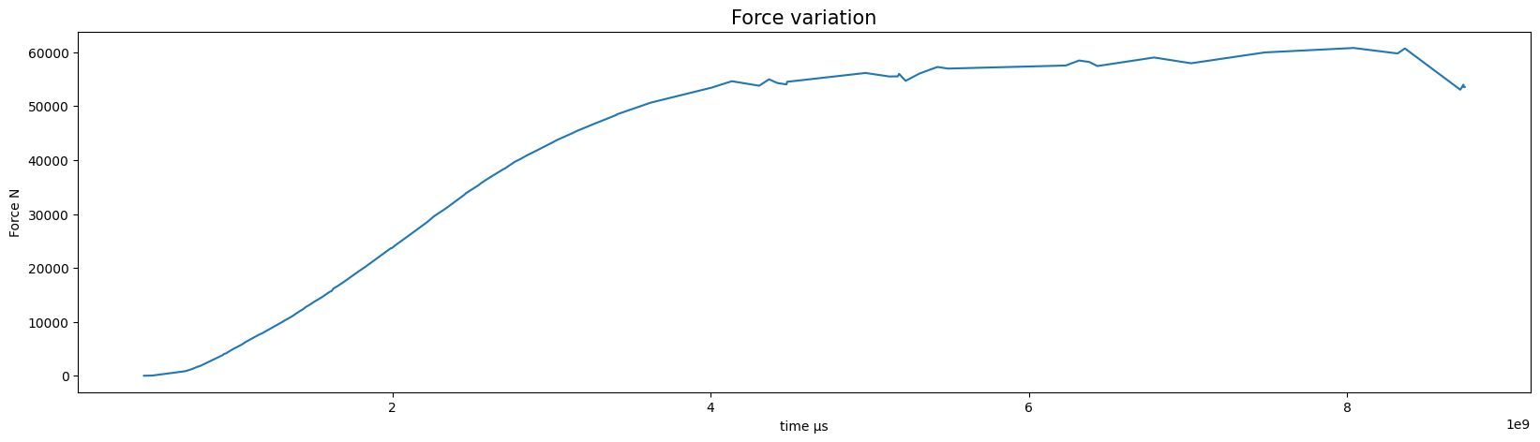
Approach (for the test case): Dataset Test3 Load data

Slide 23
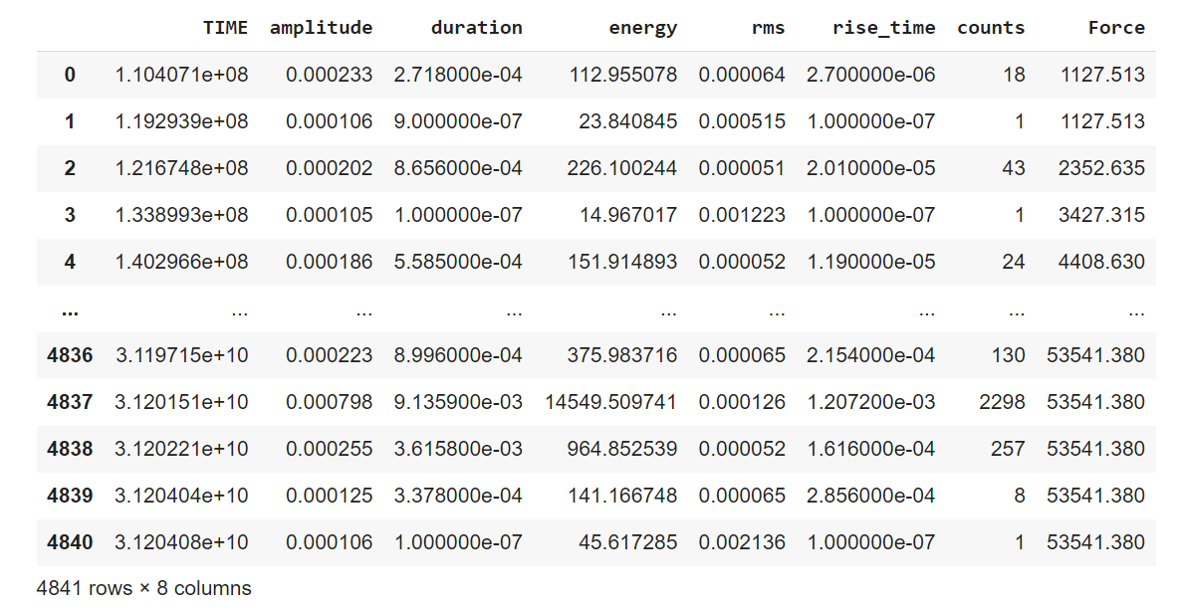
Approach: Final Dataset Step1
8 features
1 Target (Force) included in the Features: Predict the force value associated to the upcoming Hit
4840 sample: 3 tests to failure
Test1: 196 hit\
706s
Test3: 4486 hit\
1539s
Test2: 159 hit\
873s

Slide 24
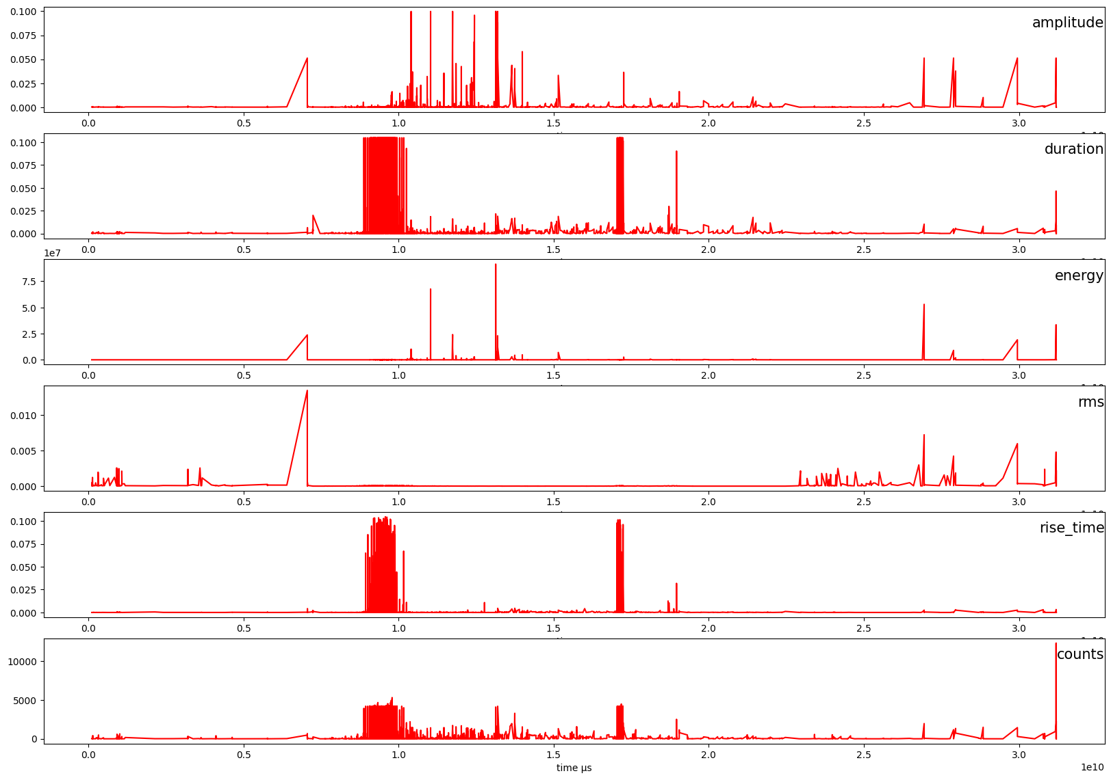
Approach: Final Dataset Step1 AE data

Slide 25
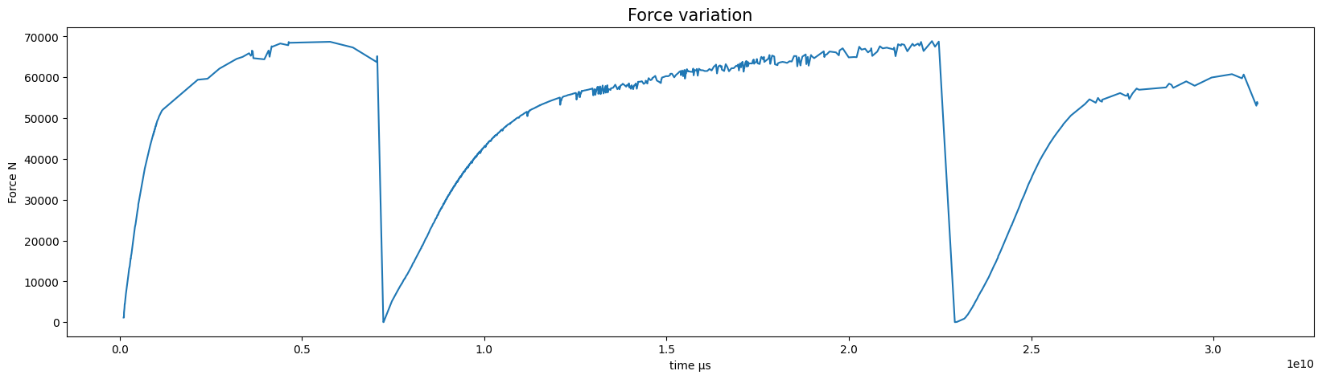
Approach: Final Dataset Step1 Load data

Slide 26
Approach: Model description Step1
Training: 4600 hits
Input at t-1
Input at:
t, t-1,.., t-n
Output at
t+1, t+2,…, t+m
Testing: 240 hits

Slide 27
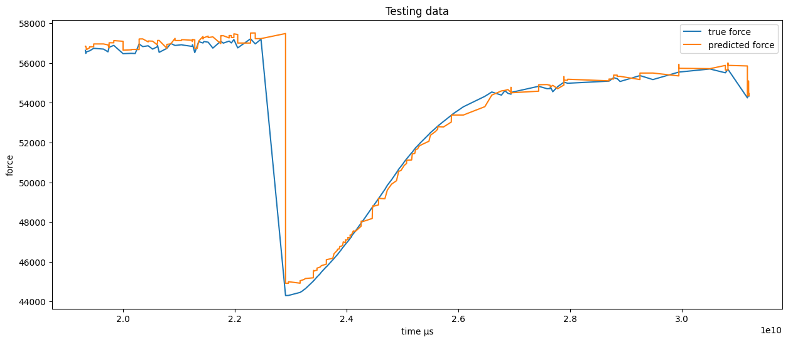
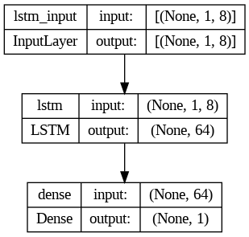
Approach: Model results Step1
Features
Time steps
Target: Force

Slide 28
Approach: Final Dataset Step2
8 features
1 Target (Time) included in the Features: Predict the Time of the upcoming Hit
4840 sample: 3 tests to failure
Test1: 196 hit\
706s
Test3: 4486 hit\
1539s
Test2: 159 hit\
873s

Slide 29
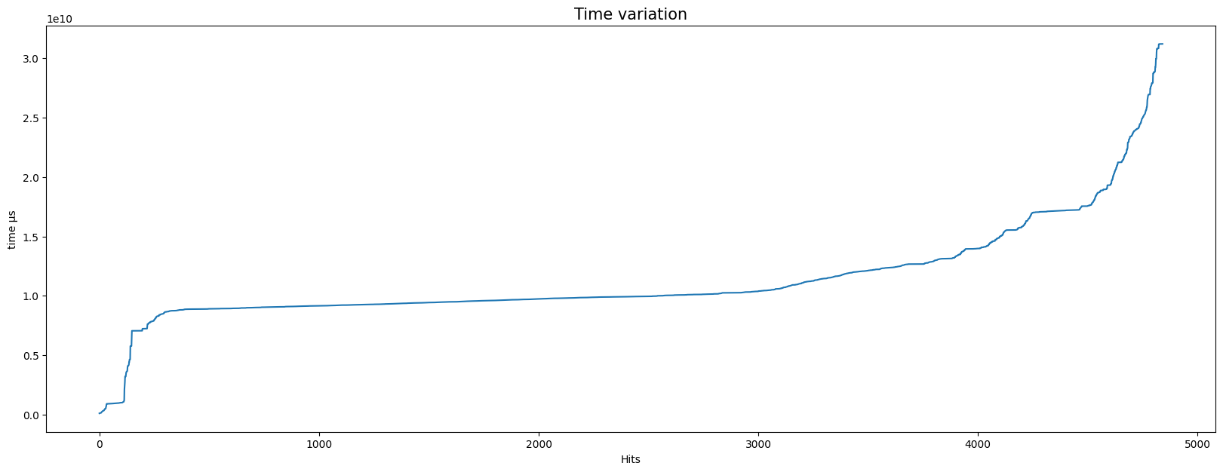
Approach: Final Dataset Step2 second Target

Slide 30
Approach: Model description Step2
Training: 4600 hits
Input at t-1
Input at:
t, t-1,.., t-n
Output at
t+1, t+2,…, t+m
Testing: 240 hits

Slide 31
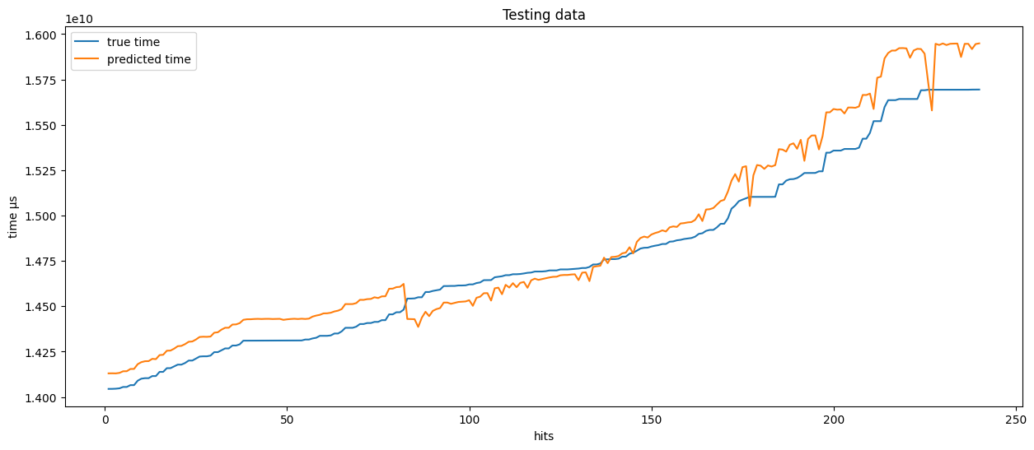
Approach: Model results Step2
Features
Time steps
Target: Time

Slide 32
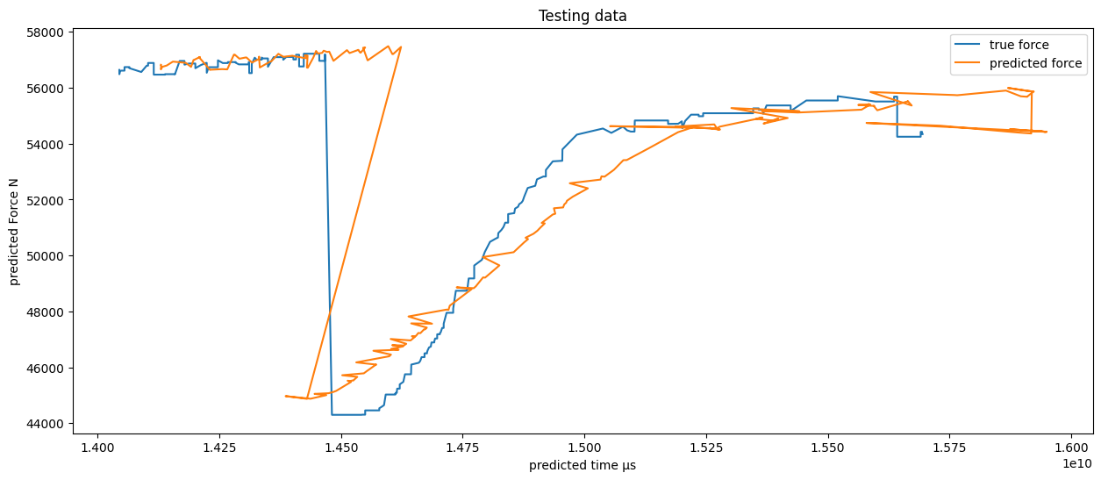
Results
Reverse the normalization : prediction = normalization*std +mean
Combine the two predictions

Slide 33
Next steps
Improve the model
Deploy the model
(Features:
AE + Force
Dashbord:
Force prediction updated in real time
DAQ
Trained Model:
Model.predict(Features)

Slide 36
annex

Slide 37
Literature review
There is no work done to predict RUL for monotonic tests
Simple forecasting (univariate or multivariate) to predict from large enough historical data
Example1: Multivariate time series prediction by RNN architectures for energy consumption forecasting
Energy Reports Volume 8, Supplement 9, November 2022, Pages 1084-1091
Example2:Multivariate Time Series Sensor Feature Forecasting Using Deep Bidirectional LSTM
Procedia Computer Science 218 (2023) 1374–1383
RUL prediction using cyclic data
Example1: Machine Remaining Useful Life Prediction via an Attention-Based Deep Learning Approach
IEEE TRANSACTIONS ON INDUSTRIAL ELECTRONICS, VOL. 68, NO. 3, MARCH 2021
Example2:Variational encoding approach for interpretable assessment of remaining useful life estimation
Reliability Engineering & System Safety volume 222, June 2022, 108353

Slide 38
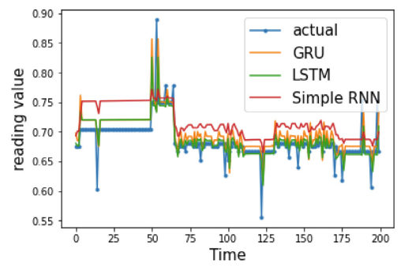
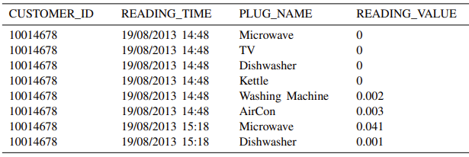
Simple forecasting (univariate or multivariate) to predict from large enough historical data Example1: Multivariate time series prediction by RNN architectures for energy consumption forecasting
The features used from the file are READING VALUE which presents the consumption rate and PLUG NAME is for specifying the tool used while consuming the energy

Slide 39
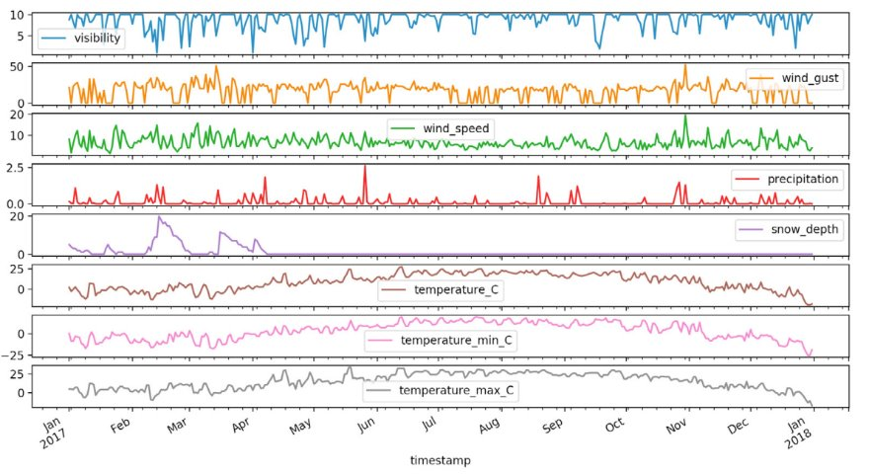
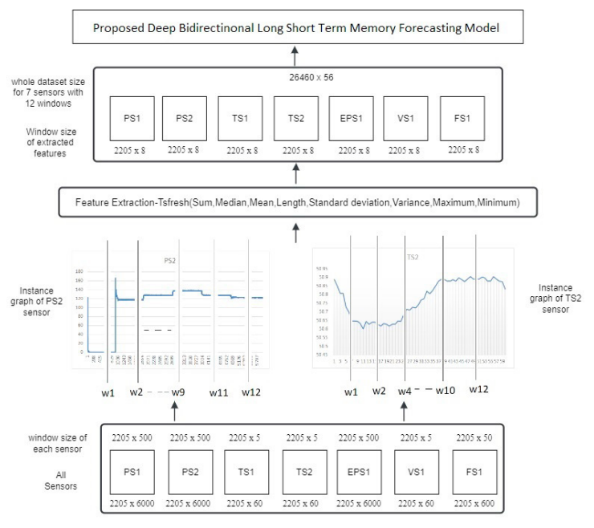
Simple forecasting (univariate or multivariate) to predict from large enough historical data Example2:Multivariate Time Series Sensor Feature Forecasting Using Deep Bidirectional LSTM
data(MTS)comprises multiple variables that are dependent on time, and every single variable relies on past data and is also interdependent on other variables.
example the size of the Motor power sensor is (2205 x 6000) i.e. 2500 instances and for each instance, 6000 samples of data is recorded. This data is divided for every 500 samples that is every window is of size wi=1,2,3...12=2205 x 500.

Slide 40
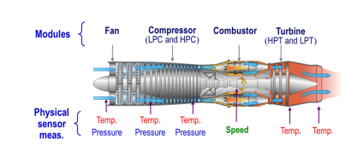
RUL prediction using cyclic data
Example1: Machine Remaining Useful Life Prediction via an Attention-Based Deep Learning Approach
The training file records sensor data at each running cycle in the run-to-fail experiments for certain number of engines. The testing file only contains the sensor measurements to certain running cycles for another certain number of engines. The objective is to predict the RUL of each engine in the testing file with the given sensor measurements.

Slide 41
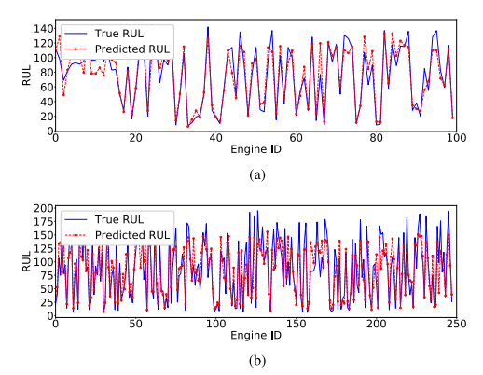
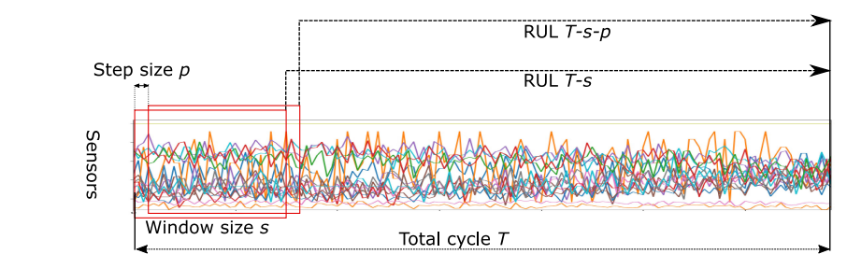
RUL prediction using cyclic data
Example1: Machine Remaining Useful Life Prediction via an Attention-Based Deep Learning Approach
For the run-to-fail experiments, assume that the number of total running cycles of an engine is T, the window size is s and the step size is p. Each sample will have a size of s × n, where n is the number of sensors

Slide 42
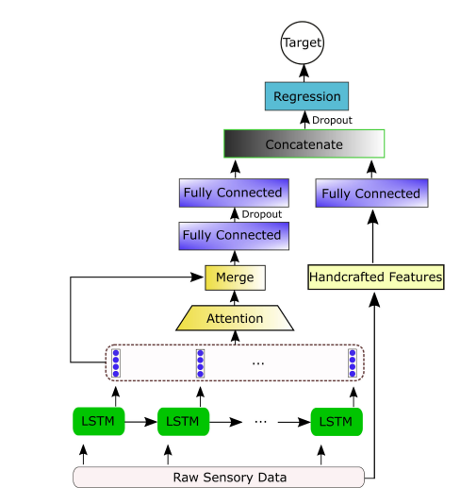
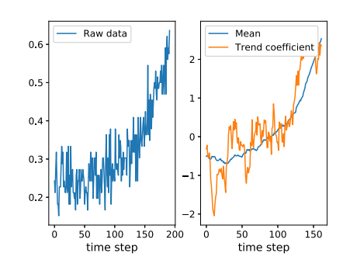
RUL prediction using cyclic data
Example1: Machine Remaining Useful Life Prediction via an Attention-Based Deep Learning Approach
Example for the features of mean and trend coefficient.

Slide 43
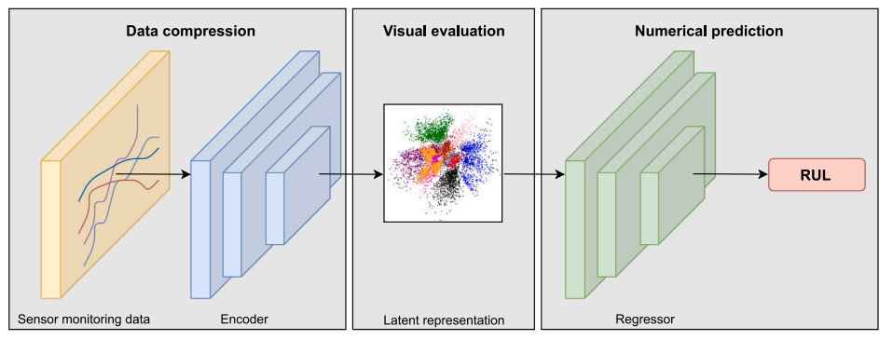
RUL prediction using cyclic data Example2:Variational encoding approach for interpretable assessment of remaining useful life estimation
The model consists of a recurrent encoder and a regression model: the encoder learns to compress the input data to a latent space that serves as a basis to build a self-explanatory map that can visually evaluate the rate of deterioration of aircraft engines. Obtaining such a latent space is regularized by a new cost function guided by variational inference and a term that penalizes prediction errors.
In anomaly diagnosis, the aim is to look for individuals in unlikely areas of the latent space. In RUL prediction, on the contrary, the objective for a complete and interpretable diagnosis should be to project the evolution of the system in the latent space over time in order to know how fast it is moving towards anomalous zones.

Slide 44
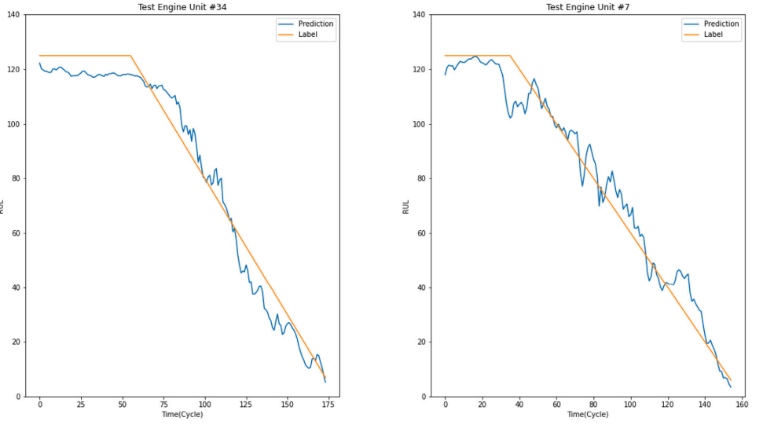
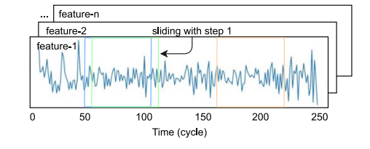
RUL prediction using cyclic data Example2:Variational encoding approach for interpretable assessment of remaining useful life estimation

Slide 45
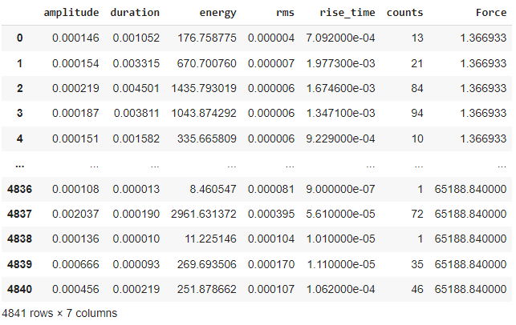
annex

Slide 46
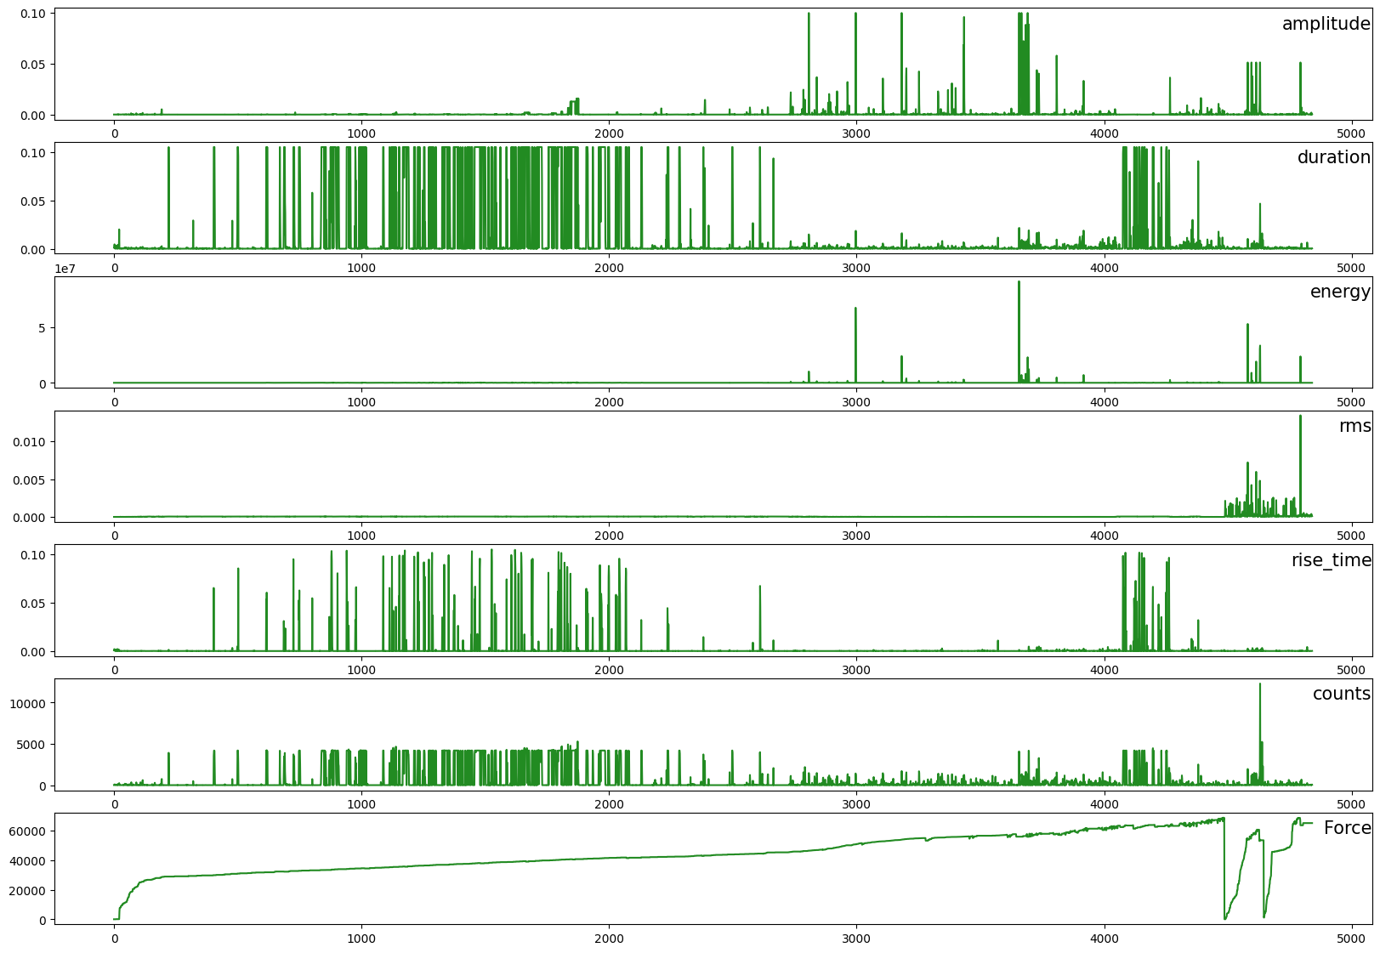
Approach: Hits as index Representative dataset: Features

Slide 47
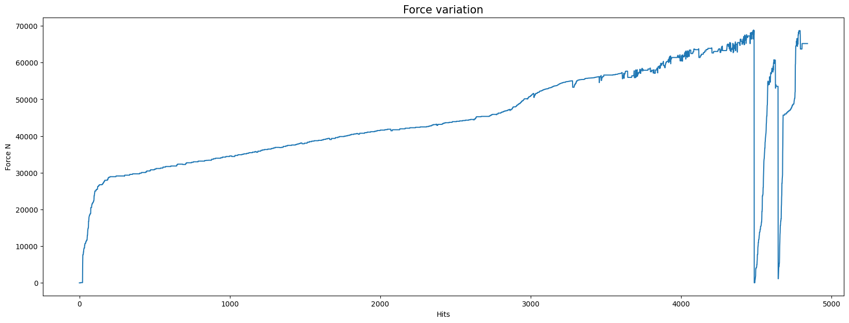
Approach: Hits as index Representative dataset: Target
test2
test1
test3

Slide 48
Approach: Model
t
t+1
amplitude
duration
energy
rms
rise_time
counts
Force
RNN Model
LSTM
GRU
TCN
Force

Slide 49
Approach: Model
Training: 4600 hits
Input at t-1
Input at:
t, t-1,.., t-n
Output at
t+1, t+2,…, t+m
Testing: 240 hits

Slide 50
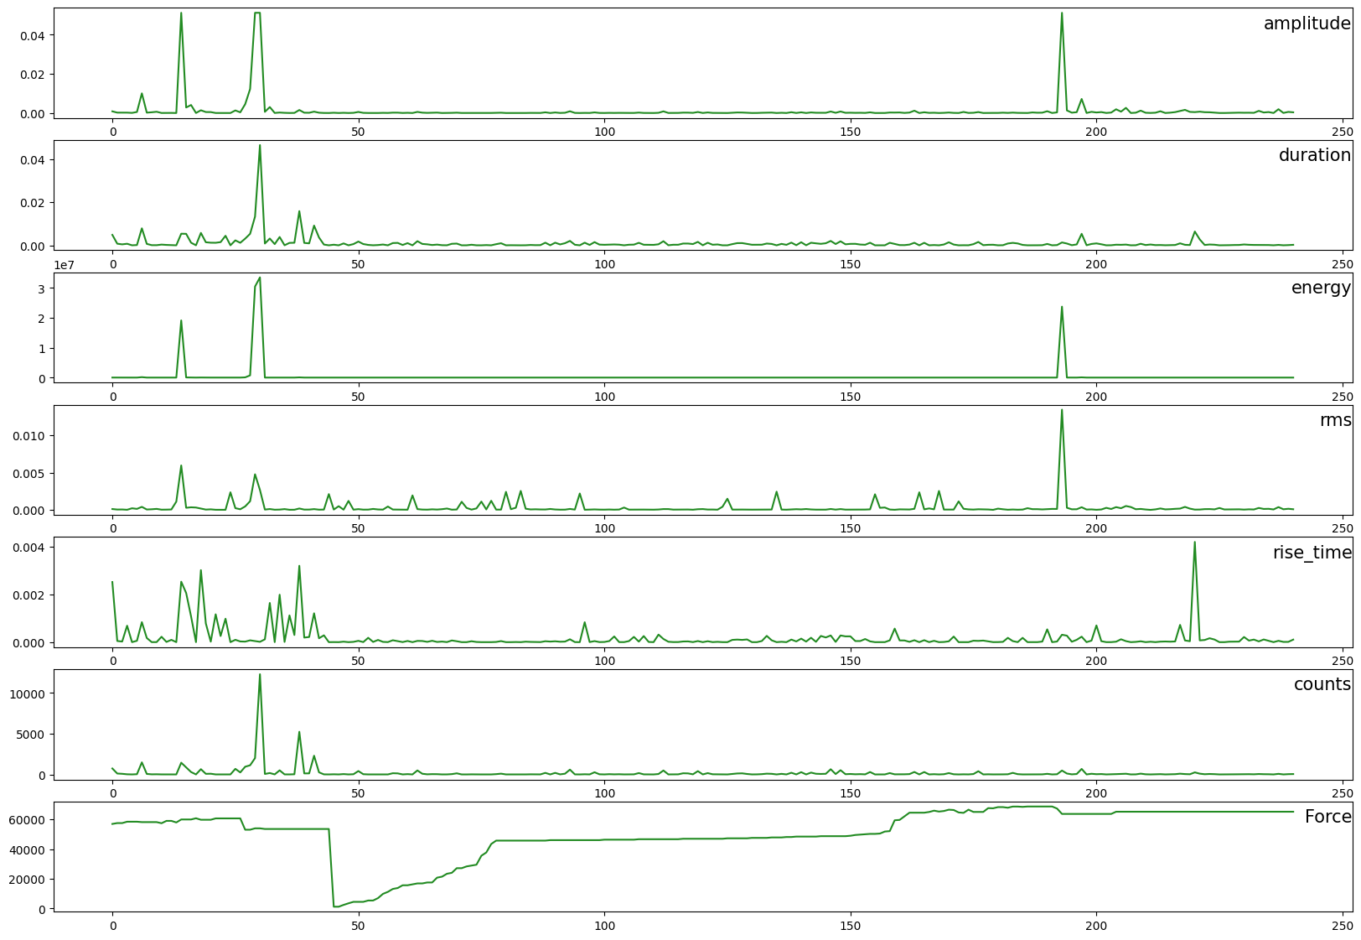
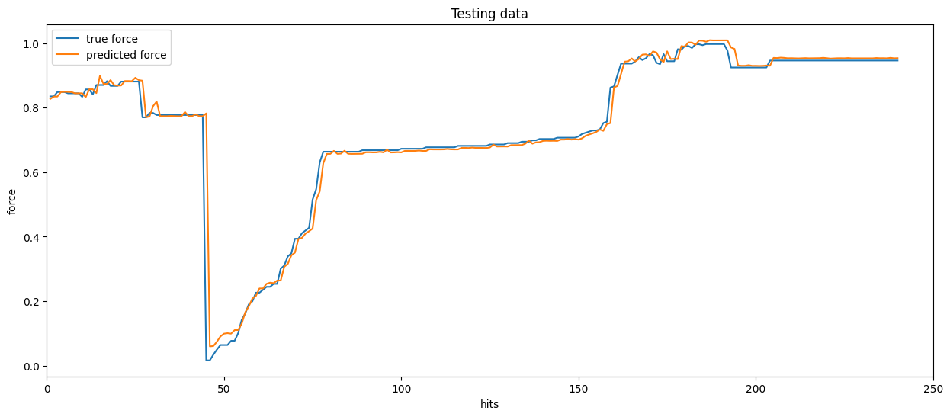
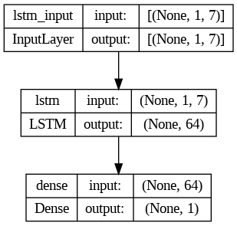
Results
Features
Time steps
RMSE = 0.05297705
Target

